Slide 1

NurtureNest
Ultimate Baby Health and Growth Companion

Slide 2


Abstract
NurtureNest is a web-based platform that simplifies managing baby health and developmental milestones. It lets parents schedule vaccination appointments, receive immunization reminders, and access vaccination records. It also offers feeding tips and mental health insights based on developmental stages. With machine learning, NurtureNest streamlines healthcare workflows, automatically extracting vaccine info from images for accurate documentation. This technology empowers parents and healthcare providers to manage a child’s well-being with personalized updates and recommendations.

Slide 3
Why NurtureNest ?
One-Stop Solution: Combines health tracking, vaccination management, and growth monitoring in one platform.
Simplifies Health Management: Easily schedule vaccinations and track baby’s health milestones in one place.
Timely Reminders: Get reminders for immunizations and appointments, ensuring no critical milestone is missed.
Personalized Care: Provides feeding tips and mental health insights based on each child’s growth phase.

Slide 4
Project Overview bond
Objective: To simplify baby health management by helping parents and healthcare providers track developmental milestones and manage vaccinations.
Platform: Connects parents and healthcare providers, offering a central hub for baby health records, vaccination scheduling, and personalized guidance.
Technology Stack: Built with Django and SQLite, using HTML, CSS, JavaScript, AJAX, and jQuery for UI and machine learning for data extraction and health insights.

Slide 5



Users
Admin
Parents
Health Centers

Slide 6
Core Functionalities of Admin
Vaccine Management: Manage and update vaccination schedules.
Feeding Chart Management: Upload and update age-based feeding suggestions.
Mental Health Tips: Curate tips to support children’s emotional health.
Stock Management: Oversee vaccine inventory and restocking.
Health Center Approval: Approve health centers for platform access.
Vaccine Request Management: Approve vaccine requests from health centers.
Patient Management: Ensure accuracy of user profiles and health records.

Slide 7
Core Functionalities of Parents
Registration and Login: Secure access for parents.
Profile Completion: Manage child profiles with personal and medical details.
Vaccine Scheduling: Schedule vaccinations with email/SMS reminders.
Notifications: Alerts for vaccinations, check-ups, and updates.
Feeding Chart: Age-based nutrition suggestions.
Mental Health Tips: Developmental-stage mental health guidance.

Slide 8
Core Functionalities of Health Centers
Vaccine Requests: Request vaccines from admin to ensure sufficient stock.
Appointment Management: Approve or reschedule vaccination appointments requested by parents.
Available Vaccines: View a list of available vaccines to meet patient needs.
Stock Management: Manage vaccine inventory for balanced stock levels.
Machine Learning Integration: Upload vaccine images, with automatic extraction of relevant details for documentation.

Slide 9

System Study
04

Slide 10
System Study
Existing Challenges
NurtureNest’s Solution
Milestone Tracking: Parents find it difficult to monitor growth and development.
Health Records: Medical history and vaccinations are scattered across platforms.
Nutrition Guidance: Lack of personalized nutritional advice for children.
Telemedicine Barriers: Limited access to providers and missed vaccination reminders can lead to missed appointments.
Growth Tracking: Monitor baby growth and developmental milestones in one place.
Centralized Records: Manage medical history, vaccinations, and appointments seamlessly.
Nutrition Plans: Offer tailored nutritional guidance based on growth stages.
Telemedicine Integration: Enable virtual consultations for timely support and advice.

Slide 11
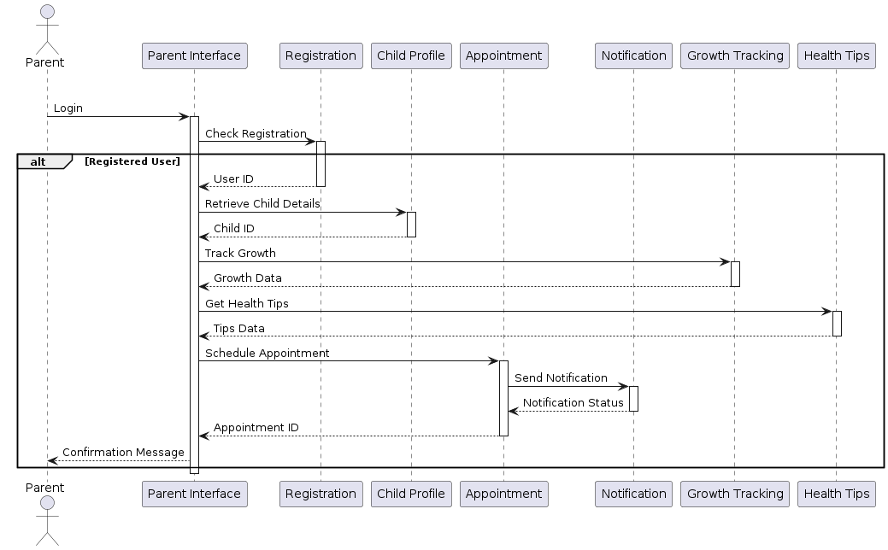
UML Diagram
System Design

Slide 12
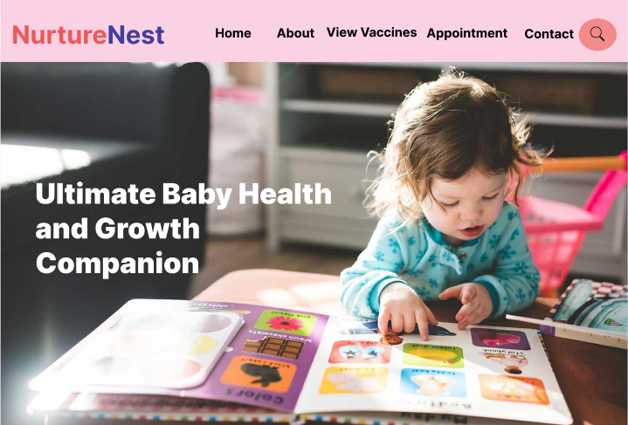
Figma Design

Slide 13
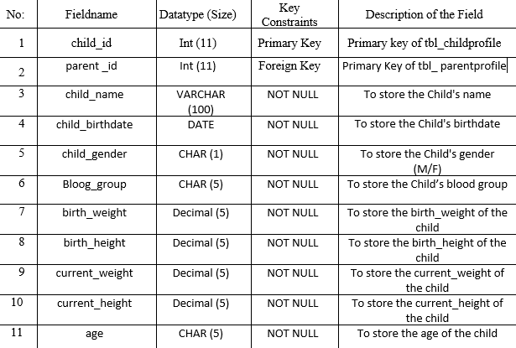
Table Design

Slide 14
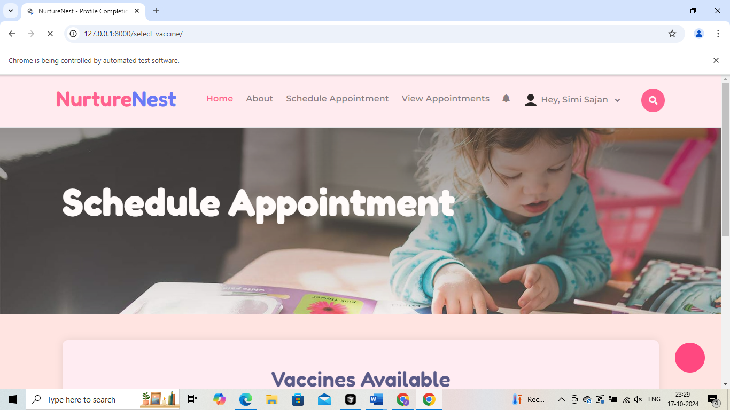
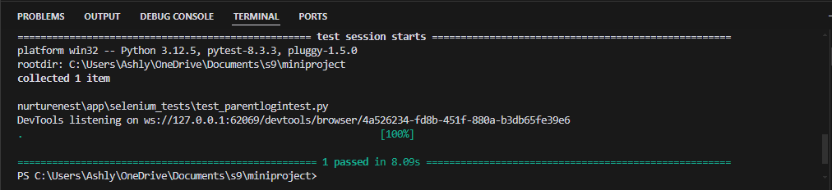
Selenium Testing

Slide 15
System Flow
NurtureNest is an innovative, web-based platform that empowers parents and healthcare providers to seamlessly manage the health and developmental milestones of young children. Designed with user-friendly features and advanced technology, NurtureNest supports every stage of a child’s growth, ensuring that parents and healthcare providers can access essential health information, stay on top of vaccination schedules, and receive timely guidance on nutrition and mental well-being.

Slide 16
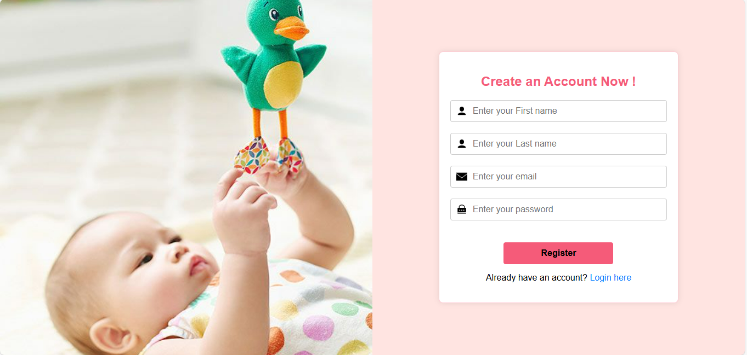
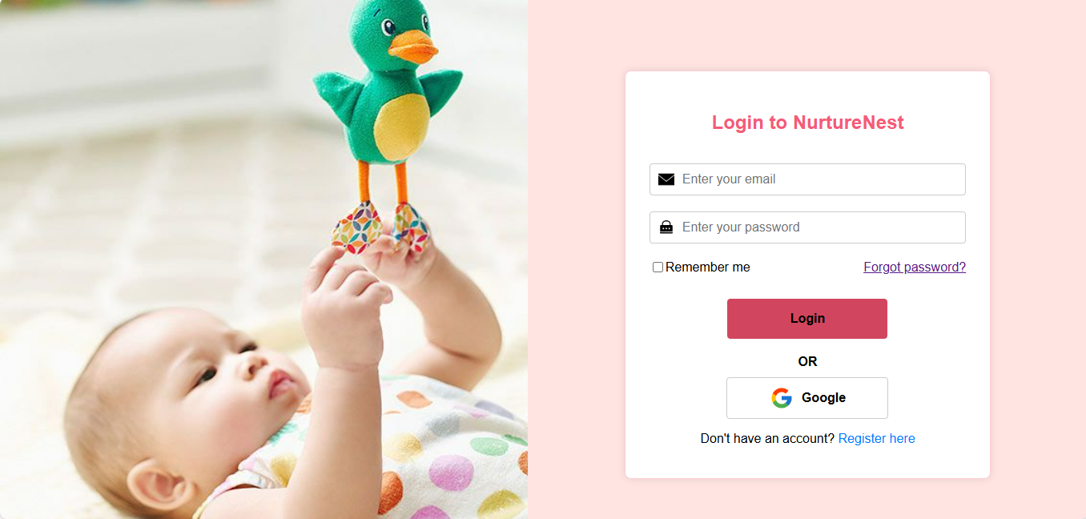
User Registration & Login
New users register by providing necessary details, setting up credentials, and selecting their role.
After completing registration, users can securely log in to access features tailored to their role.

Slide 17
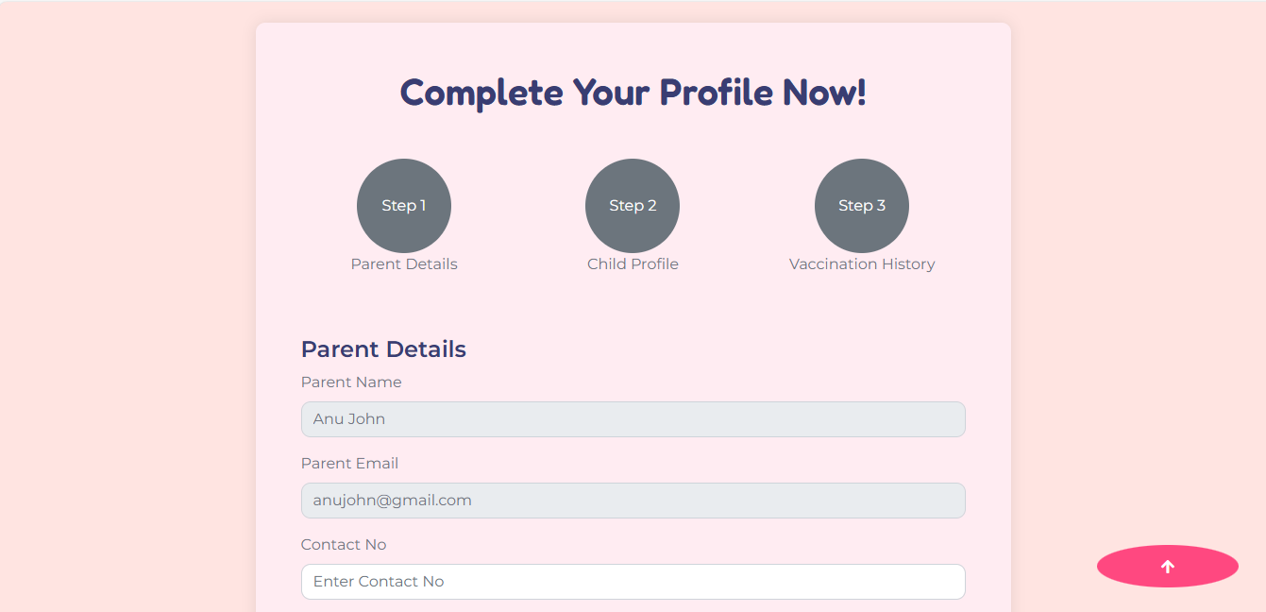
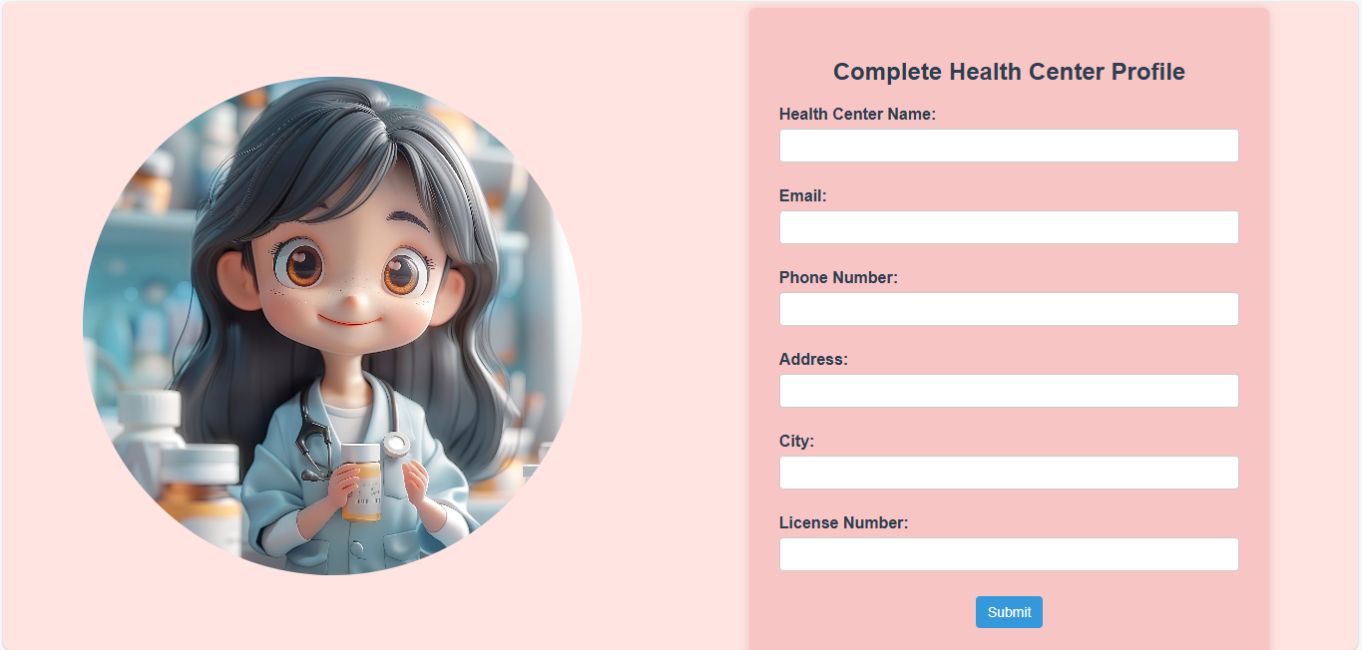
Profile Completion of Parents:
Enter essential child details to enable personalized health tracking and recommendations.
Profile Completion of Healthcare Providers
Fill out health center profile to gain access to platform features after admin approval.

Slide 18
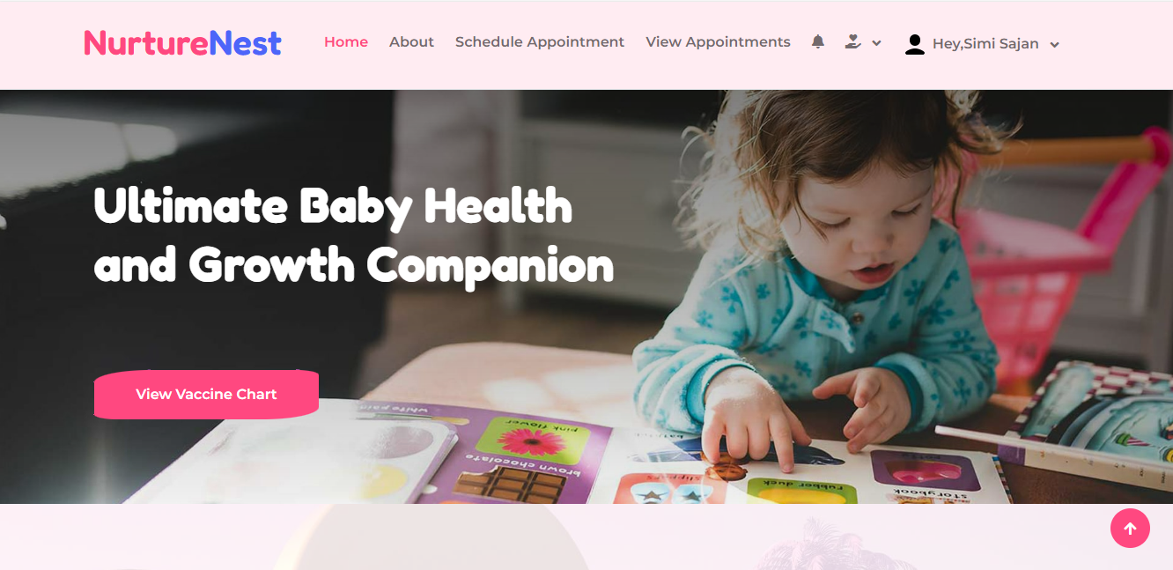
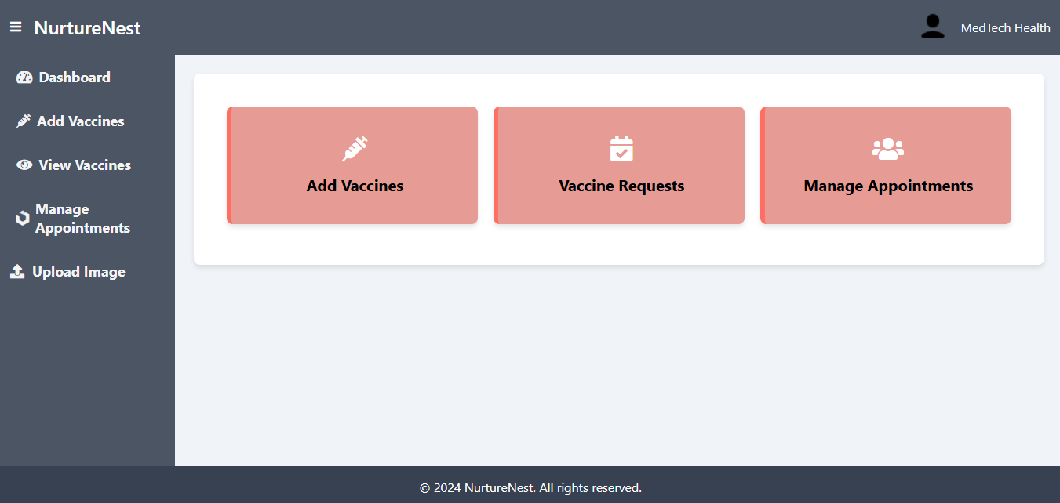
Dashboard Access & User Interface
Parents:
Access a dashboard with tailored vaccination schedules, health tips, feeding advice, and appointment reminders for your child.
Healthcare Providers
Manage appointments, patient records, and vaccine inventory all in one central dashboard.
.

Slide 19
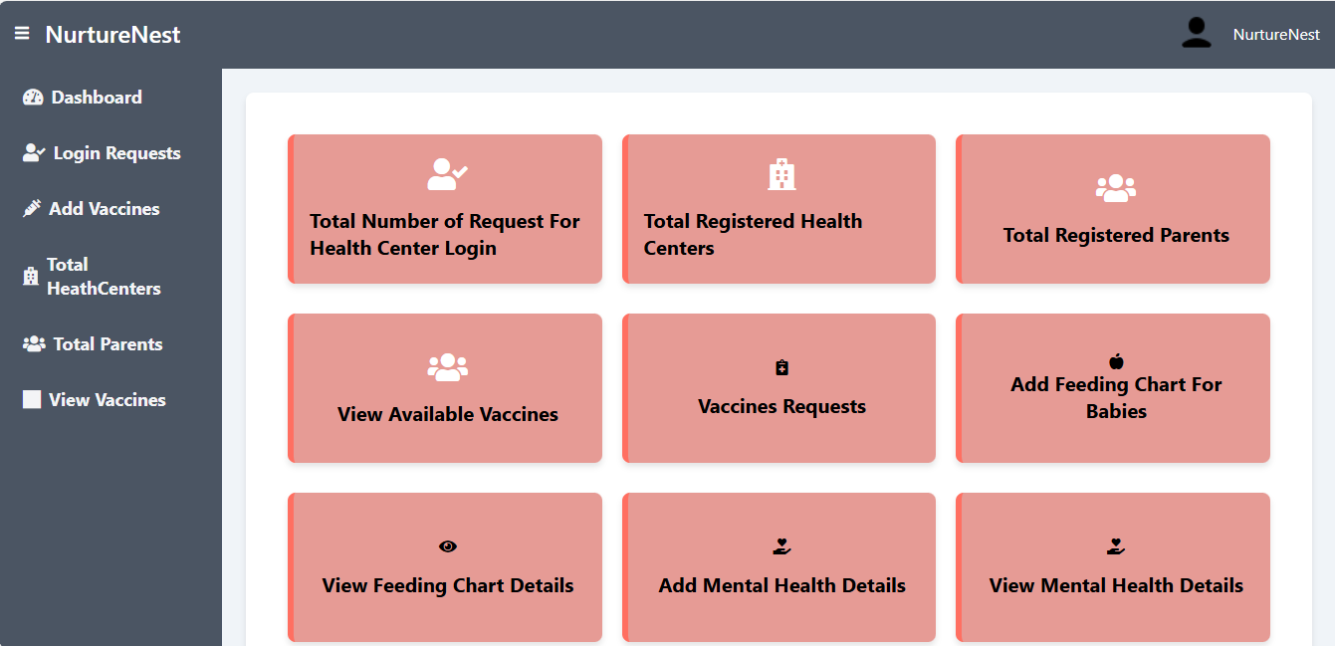
Dashboard Access & User Interface
Admin
Access a dashboard to manage users, oversee vaccine stock, update recommendations, approve health centers, and review engagement reports.

Slide 20
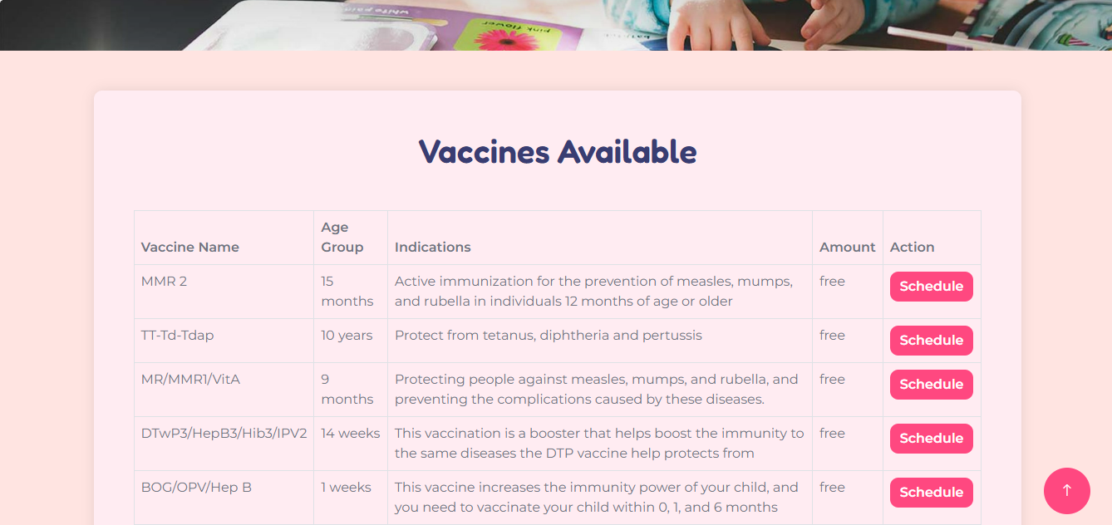
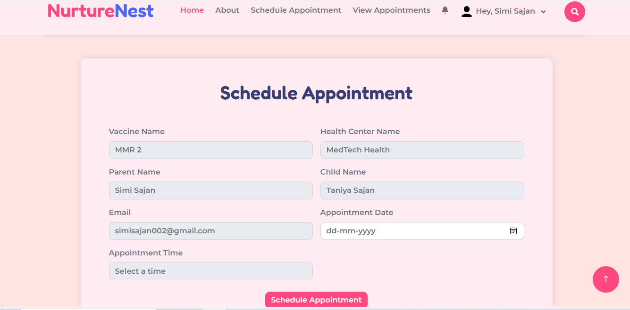
Vaccine Scheduling :
Browse available vaccines and click "Schedule" to select a health center and book an appointment.
Choose your preferred date and time on the pre-filled appointment page..

Slide 21
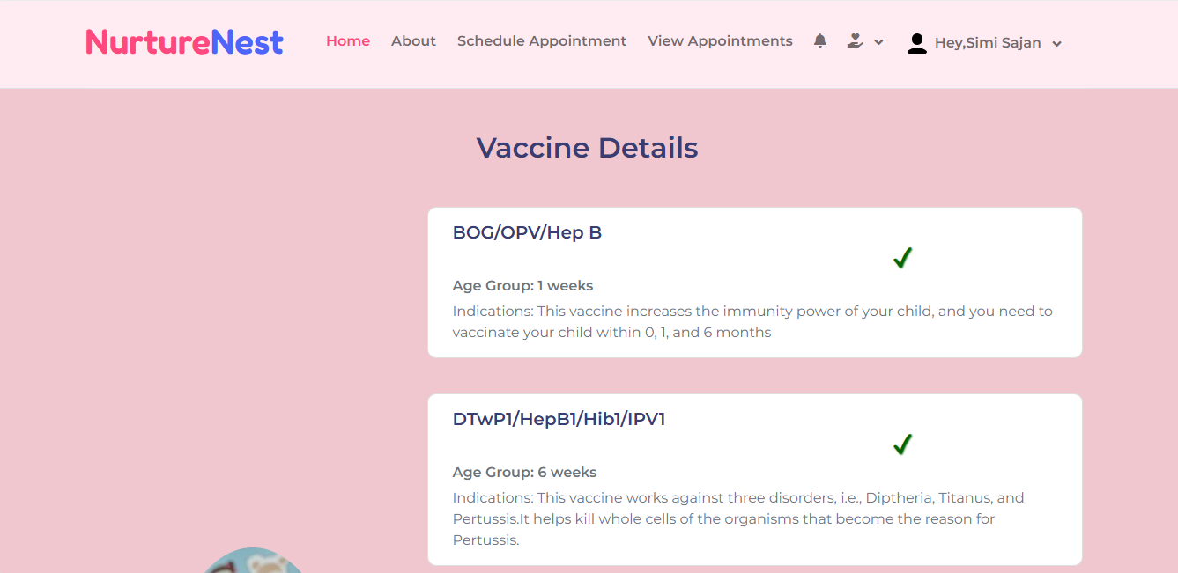
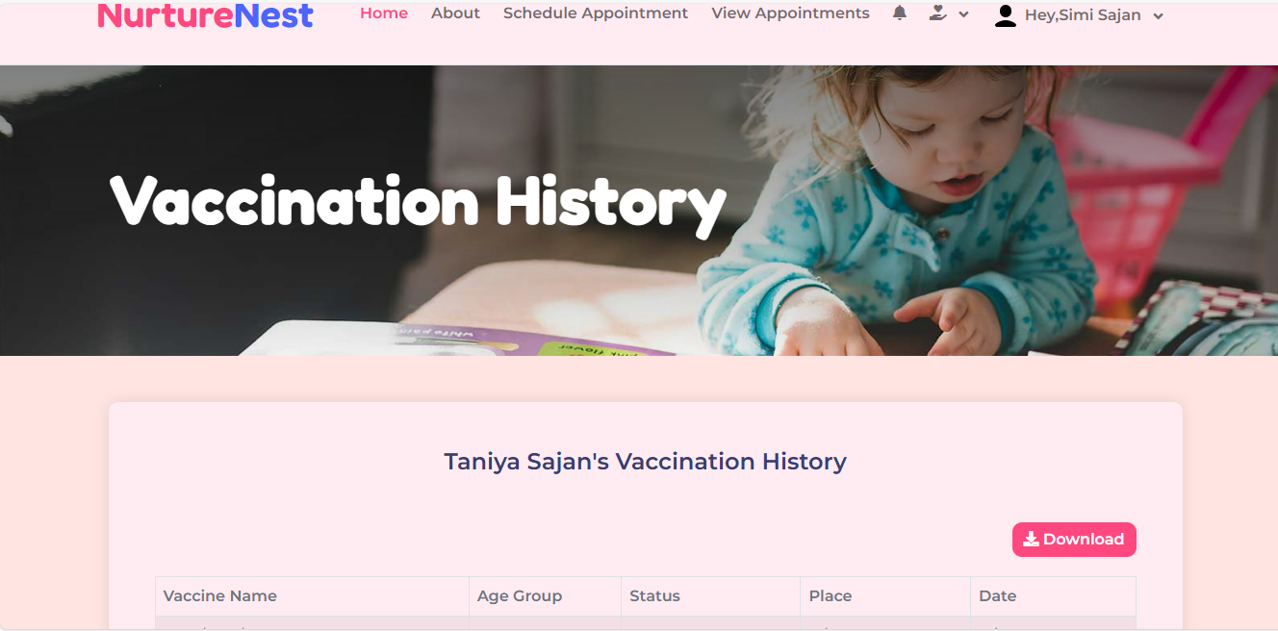
Vaccine Chart and Vaccination History:
In the Vaccine Chart, users can view all vaccines, with a clear indication of which ones are completed.
In the Vaccination History page, users can review their child’s full vaccination record and download it for their reference.

Slide 22
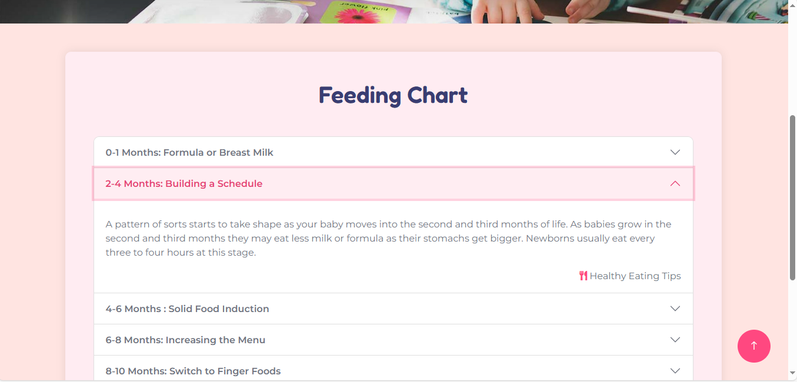
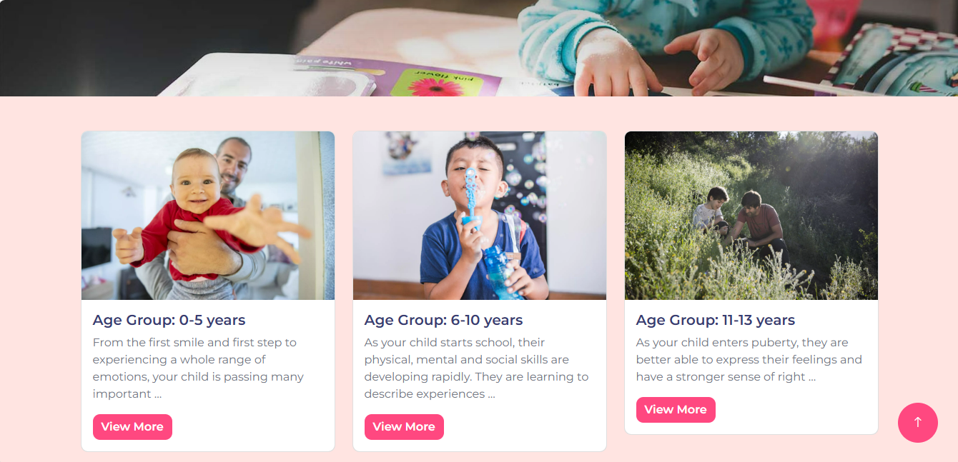
Feeding Chart and Health Guidance :
Age-based feeding tips for each growth stage.
Mental and physical health tips with insights on milestones, behaviors, and age-specific health recommendations.

Slide 23
Conclusion
In conclusion, NurtureNest is a comprehensive platform designed to support parents, healthcare providers, and administrators in tracking and managing children’s health and developmental milestones.
With features such as vaccination scheduling, feeding guidance, health tips, and secure profile management, NurtureNest simplifies the process of ensuring children receive the best possible care.
Through its user-friendly dashboard, automated reminders, and tailored recommendations, NurtureNest empowers parents and healthcare professionals alike to make informed decisions, ultimately fostering healthier, well-rounded growth for each child.

Slide 24

ThankYou

